Slide 1

  CHAPTER FOUR
  Design Issue In Embedded Systems

Slide 2

Module Outline
Memory management
Hardware development
Software development

Slide 3
Cntd…
Here are the requirements of memory management:
Relocation. The memory available to us gets shared among various processes present in a multiprogramming system. ...
Protection. ...
Sharing. ...
Logical Organization. ...
Physical Organization.

Slide 4
Introduction to Memory
Embedded platforms can have a memory hierarchy.
It has a collection of different types of memory, each with unique speeds, sizes, and usages.
Some of this memory can be physically integrated on the processor, like registers
Certain types of memory can be connected directly to the master processor, such as RAM, ROM, and cache,
While other types of memory, called secondary memory, are connected to the master processor indirectly via another device such as CD-ROM, floppy drives, hard drives, and tape.

Slide 5
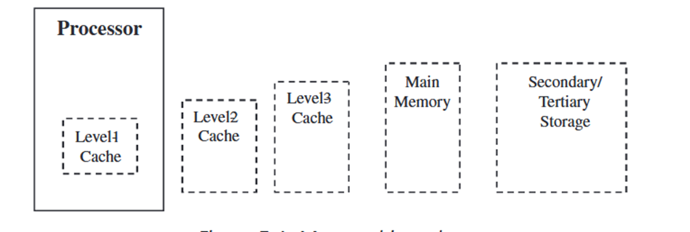
Cntd…
Memory hierarchy
At the highest level, both primary and secondary memory can be divided into two groups, non-volatile or volatile.
On embedded boards, there are two types of non-volatile memory Families
    ROM and auxiliary memory
One family of volatile memory
    Random-access memory (RAM)

Slide 6
Cntd…
i. Read-Only Memory (ROM)
It is a type of non-volatile memory that can be used to store data on an embedded system permanently.
Typically through a smaller on-board battery source that is separate from the board’s main power source.
The type of data stored on ROM in an embedded system is the software required by the device to function in the field after being dispatched out of the factory.
The contents of ROM can only be read by the master processor
However, depending on the type of ROM, the master processor may or may not be able to erase or modify the data located in ROM.

Slide 7
Cntd…
The most common types of ROM used on embedded boards are
i. Mask ROM (MROM).
Data bits are permanently programmed into a microchip by the manufacturer of the external MROM chip.
MROM designs are usually based upon metal oxide semi conductor (MOS) (NMOS, CMOS) or bipolar transistor-based circuitry.
This was the original type of ROM design.
Because of expensive set-up costs for a manufacturer of MROMs, it is usually only produced in high volumes, and there is a wait time of several weeks to several months.
However, using MROMs in design of products is a cheaper solution.

Slide 8
Cntd…
ii. One-Time Programmable ROM (OTP or OTPRom).
This type of ROM can only be programmed permanently one time.
but it can be programmed outside the manufacturing factory, using a ROM burner.
OTPs are based upon bipolar transistors, in which the ROM burner burns out fuses of cells to program them to “1” using high voltage/current pulses
iii. Erasable Programmable ROM (EPROM).
An EPROM can be erased more than one time using a device that outputs intense short-wavelength, ultraviolet light into the EPROM package’s built-in transparent window.
OTPs are one-time programmable EPROMs without the window to allow for erasure; the packaging without the window used in OTPs is cheaper.
EPROMs are made up of MOS (i.e., CMOS, NMOS) transistors

Slide 9
Cntd…
iv. Electrically Erasable Programmable ROM (EEPROM).
Like EPROM, EEPROMs can be erased and reprogrammed more than once.
The number of times erasure and re-use occur depends on the EEPROMs.
Unlike EPROMs, the content of EEPROM can be written and erased “in bytes” without using any special devices.
In other words, the EEPROM can stay on its residing board, and the user can connect to the board interface to access and modify an EEPROM
A cheaper and faster variation of the EEPROM is Flash memory.
Where EEPROMs are written and erased at the byte level, Flash can be written and erased in blocks or sectors (a group of bytes).
Like EEPROM, Flash can be erased electrically, while still residing in the embedded device.
Unlike EEPROMs, which are NMOS-based, Flash is typically CMOS-based

Slide 10
Cntd…
Uses for the Different ROMs
Embedded boards can vary widely in the type of board ROMs they use, not only in the production system but even throughout the development process.
E.g., , at the start of development, more expensive EPROMs may be used to test the software and hardware,
Whereas OTPs may be used at the end of development stages to provide different revisions of the code for a particular platform to other groups
The ROMs actually used in mass production and deployed in an embedded system could be the MROMs (the cheapest solution of the above family of ROM ICs).
On more complex and expensive platforms, Flash memory may be the only ROM used through the entire device development and deployment process, or used in combination with another type of ROM, maskROM

Slide 11
Cntd…
Random-Access Memory (RAM)
It commonly referred to as main memory, any location within it can be accessed directly and randomly, rather than sequentially
Unlike ROM, contents of RAM are erased if the board loses power
The two main types of RAM:
  Static RAM (SRAM) and
  Dynamic RAM (DRAM).
Level-2+ Caches: Level 2+ cache is the level of memory that exists between the CPU and main memory in the memory hierarchy.
Auxiliary Memory
It is typically nonvolatile memory used to store larger amounts of regular, archival, and/or backups of data, for longer periods of time.

Slide 12
Memory Management
It used to be the preserve of workstations and PCs where it is used to help control and manage the resources within the system.
It unavoidably caused memory access delays and extra cost, because of this, was rarely used in embedded systems.
Another reason, was that many of the real-time OS did not support it
While some form of memory management can be done in software,
But, memory management is usually implemented with additional hardware called a MMU (memory management unit) to meet at least one of four system requirements.
  1. The need to extend the current addressing range
  2. To remove the need to write relocatable or position-independent software
  3. To partition the system to protect it from other tasks, users, etc.
  4. To allow programs to access more memory than physically present in the system

Slide 13
Cntd…
1. The need to extend the current addressing range.
The need for memory management is usually the result of prior experience or background, and centers on extending the current linear addressing range.
The Intel 80x86 architecture is based around a 64 kbyte linear addressing segment which, while providing 8 bit compatibility, does require memory management to provide the higher order address bits necessary to extend the processor ́s address space.
Software must track accesses that go beyond this segment, and change the address accordingly.
The M68000 family has at least a 16 Mbyte addressing range and does not have this restriction.

Slide 14
Cntd…
2. To remove the need to write relocatable or position-independent software.
Many systems have multitasking OS where the software environment consists of modular blocks of code running under the control of an OS.
Software can be written in such a way that it is either relocatable or position independent.
These two terms are often interchanged but there is a difference: both can execute anywhere in the memory map,
but relocatable code must maintain the same address offsets between its data and code segments.
The main technique is to avoid the use of absolute addressing modes, replacing them with relative addressing modes.
If this support is missing or the compiler technology cannot use it, memory management must be used to translate the logical program addresses and map them into physical memory.

Slide 15
Cntd…
3. To partition the system to protect it from other tasks, users, etc.
To provide stability within a multitasking or multiuser system, it is advisable to partition the memory so that errors within one task do not corrupt others.
In general level, OS resources may need separating from applications.
This partitioning is very rough, but is often necessary in many cases.
Memory management can be used to add extra description bits to an address to declare its status.
If a task attempts to access memory that has not been allocated to it, or its status does not match (e.g. writing to a read only declared memory location), the MMU can detect it and raise an error to the supervisor level.
This aspect is becoming more important and has even urged manufacturers to define stripped down MMUs to provide this type of protection

Slide 16
Cntd…
4. To allow programs to access more memory than is physically present in the system.
With the large linear addressing offered by today ́s 32 bit microprocessors, it is relatively easy to create large software applications which consume vast quantities of memory.
While it may be feasible to install 64 Mbytes of RAM in a workstation, the costs are expensive compared with a 64 Mbyte Winchester disk.
As the memory needs go up, this differential increases.
A solution is to use the disk storage as the main storage medium, divide the stored program into small blocks and keep only the blocks in the processor system memory that are needed.
As the program executes, the MMU can track how the program uses the blocks, and swap them to and from the disk as needed.
If a block is not present in memory, this causes a page fault. In this way, the system appears to have large amounts of system RAM when, in reality, it does not..

Slide 17
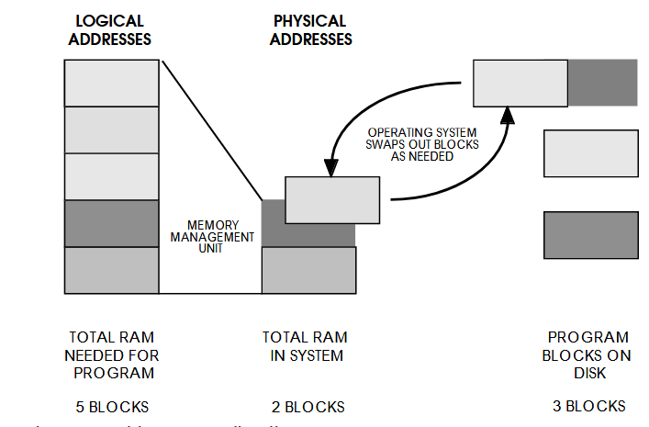
Cntd…

Slide 18
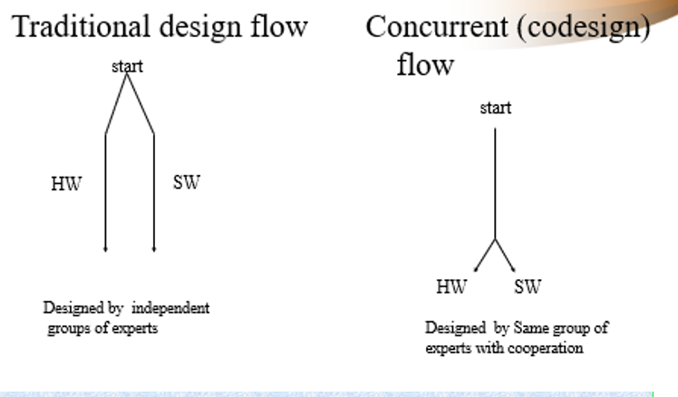
Design of embedded System

Slide 19
Embedded system Design Requirement
Embedded system must satisfy the following:
  Real time operation reactive to external events
  Conform to size and weight limits
  Budget power and cooling consumption
  Satisfy safety and reliability requirements
  Meet tight cost targets

Slide 20
Design challenges in embedded systems
The major challenges faced during embedded system design:
  Type and amount of hardware needed
  Optimizing the power dissipation and energy consumption
  Process deadlines
  Flexibility and ability to upgrade
  Reliability
1. Type and amount of hardware: Hardware based on system on chip (SoC) or Very large-scale integration (VLSI) design has very high Non-Recurring engineering (NRE ) cost and hardware design on a circuit board depends on available chips.
2. Optimizing the power dissipation and energy consumption: It is one of the most challenges of embedded system is power dissipation and energy consumption.

Slide 21
Cntd…
3. Process deadlines
Meeting the deadline of all processes in the system while keeping the memory, power dissipation, processor clock rate and cost at minimum is a challenge.
4. Flexibility and the ability upgrade
Flexibility in design at little cost overhead is a challenge.
Ability to upgrade: the design while keeping the cost minimum

Slide 22
              Others
A. Cost and type of hardware needed
Optimizing the microprocessors, application-specific instruction-set processor (ASIPs) and single purpose processors in the system.
  Hardware software participation
  How much H/W How much S/W?
Optimization – according to the performance, power dissipation, cost and other design metrics the system.
B. Testing
Find errors and to validate that the implemented product is as per the specifications and requirements to get reliable product.
C. verification
Ensure specific functions are correctly implemented

Slide 23
Cntd…
D. Time-to-prototype, Time-to-market
The time needed to build a working version of the system.
The time required to develop a system to the point that it can be released and sold to customers.
E. Maintainability
The ability to modify the system after its initial release
Correctness, safety
F. Validation
To ensure that the system that has been created is a s per requirements agreed upon at the analysis phase, and to ensure its quality.

Slide 24
Challenges and Issues of Embedded Software Development
Embedded software, often called firmware, permanently resides in its dedicated hardware creating a single embedded software.
Our daily environment, whether at work or home, is full of embedded software.
Every electronic device is capable of fulfilling “smart” functions only due to its native embedded software.
The full range of computer peripherals like monitors, printers, routers, digital cameras, flesh memory sticks, headphones, etc.
As well as household appliances like washing machines, microwave ovens, digital TVs, video cams, mobile phones, etc., at the core are all built around embedded software

Slide 25
Cntd…
Embedded software is always a constituent of a larger system.
Such embedded solutions must have real-time response under all circumstances within the time specified by design and operate under the condition of limited memory, processing power and energy supply.
Moreover, embedded software must be immune to changes in its operating environment processors, sensors, and hardware components may change over time.
Other challenging requirements to embedded software are
  Portability and
  Autonomy

Slide 26
Cntd…
Stability is of supreme importance.
Unexpected behavior from an embedded software is prohibited and poses serious risks.
End users demand that embedded software must have uniform behavior under all circumstances.
Safety is a special feature of embedded software due to their primary application associated with lifesaving functionality in critical environments.
Software Development Life Cycle (SDLC) for embedded software is characterized by more strict requirements and limitations in terms of quality, testing, and engineering expertise.
Security: became a burning issue in the digital world.
  The related risks grow exponentially, especially so for IoT devices.

Slide 27
Cntd…
Compatibility and Integrity
Most of the apps in the market are launched by businesses younger than 3 years old.
With all their probable expertise in software development, many of them lack practical experience in implementing and updating their applications.
Further, expansion of IoT devices on the background of their connectivity puts more pressure on their adaptability.
Users must be capable of administering the app through a simple user interface via all available channels including over-the-air firmware updates, which needs extreme compatibility across the entire ecosystem.
Integrity becomes a function of security.

Slide 28
Key Issues of Embedded Software Development
The number of connected devices worldwide grows exponentially each year.
Embedded solution developers are facing many specific issues along this way.
let us have a look at a few of them.
Connectivity
There are so many different ways to connect device to the internet.
  Wireless connection can be established through Wi-Fi, Ethernet, Edge, a Bluetooth bridge, and other channels.
Leaving apart their pros and cons, the fact is each of them is created with a different technology stack, which means that developers have to have expertise in all of them.

Slide 29
Cntd…
In addition, it is complicated with an issue, which protocol to use: UDP, TCP/IP, etc.
Pre-engineered software stacks partially resolve this complexity, but the issue remains for developers to have enough knowledge to understand a problem if something breaks or requires modification.
II. Over-the-air Updates
The issue standing next to connection to the internet is remote updates of the firmware.
In case of standalone device, it is enough to send update to a secure site and notify users to download and install it.

Slide 30
Cntd…
Then, developers have to fulfill the following tasks:
  generate a firmware update,
  save it to the devices,
  validate that they are delivered from a trusted source,
  run the update on the devices at appropriate time, and
  be ready to roll back the update if there is an issue.
This job is fairly tough and time-consuming, requires a lot of skill from developers, who have to be experienced in deploying the updates in the IoT environment.

Slide 31
Cntd…
III. Debugging
Debugging is a general issue growing together with the number of connected devices, i.e. time and effort for debugging grows in parallel.
Along with the process of open source software integration, there occurs more unexpected behaviors in a system adopting in numerous free flow devices than in the one which was specifically designed to interact with them from the start.
Many embedded software developers voice that every embedded project incurs extra cost for debugging consuming up to 40% of developers’ time.

Slide 32
Cntd…
IV. Pace of Change
  For a few decades, technologies used for embedded software were almost the same with some new higher capacity processor to come out once a year.
  Then things eventually began speeding up.
  In the last 5 years, we witness fast development of emerging technologies including artificial intelligence.
  It creates a problem for developers, because available technologies are changing faster than they can get hold of them

Slide 33
Thank You!!

